Slide 1
OSSLT
Tuesday, April 10, 2018
Arrive At 8:30

Slide 2
OSSLT – Tuesday, April 10, 2018
All eligible secondary students across the province will write the Ontario Secondary School Literacy Test on Tuesday, April 10, 2018.
This test is a requirement for your Ontario Secondary School Diploma.
In a few months you will receive an Individual Student Report indicating whether or not you have passed. You need 75% to pass.

Slide 3
OSSLT – Tuesday, April 10, 2018
The test will take approximately three and half hours.
This does not include time at the beginning of the test (when instructions will be read to you, nor does it include the 15 minute break you will get between the two sessions).

Slide 4
Each booklet contains various reading selections, writing tasks, and questions.
Visit
eqao.com
for sample questions, answers, and past tests.

Slide 5
Timelines
Special Ed., and ESL students have additional time to complete each booklet.
Follow the instructions Ms. Petrovits or Ms. Zhou has already given you.

Slide 6
TIMELINEs
8:30 students arrive at school; take care of bathroom needs.
8:45 students are seated in the assigned classroom.
If you have not already done so, see the posted lists in the main hall, in front of the library, and in the ESL hall to know where you will be writing.
If you are taking Special Ed. or ESL courses you may be writing in a different room.
Other Notes:
1. There will be no cafeteria service that day.
2. There is no access to the 3rd floor before 2:30, if your locker is on the 3rd floor, you must make sure you do not need access to it that day.

Slide 7
TIMELINEs
8:45 a.m. – Teachers begin to read important information to students.
8:55 a.m. – Students receive the test material and confirm that they have everything they need.
9:00 a.m. – Students open Session 1 booklets and begin.

Slide 8
TIMELINEs
10:30– 10:40 Students have a snack and take a washroom break.
10:40 – Students are back in room and ensure they are sitting in the same seat that they were in when they completed Session 1 booklet.

Slide 9
TIMELINEs
10:45
Students receive instructions and begin to work on Session 2
10:45-12:30
Students complete Session 2 booklet, complete a student questionnaire, wait until all tests and questionnaires are completed and collected, and then are dismissed.

Slide 10
Punctuality & Absenteeism

Slide 11
Punctuality & Absenteeism
You must be in your seat and ready to start at 8:45 a.m.
so that:
you have the correct test material registered to your name.
you hear the instructions the teacher will give you.
check the identification numbers of your documents to see that the final 12 digits all match. If they do not, report the problem to the teacher in charge.

Slide 12
Punctuality & Absenteeism
Write down the room you are writing
Check the lists posted in the main hall and in front of the library.
It is a good idea to locate that room today so you will know where to go on Tuesday.

Slide 13
Punctuality & Absenteeism
You must be at school on time to write the test. If you are late, you will only be allowed to write the booklets being completed at the time.
You will not have the instructions repeated to you, and you will not be given any extra time to make up for the time that you have missed. Being late will reduce your chances of passing.
If you are absent, you will be required to take the test at the next administration, which is not until Spring 2019.

Slide 14
What to bring

Slide 15
What to Bring
Bring blue or black pens. Any work done in pen other than blue or black ink will not be scored.
Also, bring several sharpened pencils and an eraser. The white erasers work better when erasing material in pencil than the pink erasers found on the end of pencils.
Bring highlighters to use on the text in the booklets when you are keeping track of important information.

Slide 16
What to Bring
You are not allowed to use Whiteout.
You are allowed to bring water
Bring a book to read. You are not allowed to leave the room until you are dismissed.
All coats, bags and electronic devises will be placed in the front of the room; you will not have access to them until the entire test is over.

Slide 17
WHAT YOU NEED TO KNOW

Slide 18
What You Need To Know
ESL students writing on the 3rd floor may not leave until after 1:30 p.m. You will get a lunch break.
There will be no cafeterias service that day.
Bring your lunch.

Slide 19
What You Need To Know
There will be no access to the 3rd floor until after 2:30 p.m. on the day of the test
Therefore, anything you will need for Tuesday you must get from your locker on Monday before you leave school for the day.

Slide 20
TEST PROTOCOL

Slide 21
TEST PROTOCOL
Wait for instructions before unwrapping the booklet.
Remember once the test begins, teachers will not be able to answer any questions.
On the inside of each of your test booklets, you will find instructions. Follow the instructions carefully.

Slide 22
Test PROTOCOL
Do not skip lines when you write.
Write clearly. Handwriting that cannot be read will not be scored.
If you write offensive material, your work may not be scored and the principal will be notified.
Straightforward, specific examples from the text is ideal

Slide 23
TEST PROTOCOL
If you have any questions once the instructions have been read to you, before the test begins, ask them immediately so the teacher can answer you.
Remember to answer all questions. Failing to do so, or leaving a question blank, will reduce your chances of success.

Slide 24
TEST PROTOCOL
You will be answering all multiple-choice questions in the Answer Booklets. Remember to bring several sharpened pencils and an eraser to do this.
If you wish to change a multiple-choice answer, erase your answer and fill in the circle for your new answer. Do not use whiteout. Ensure that your final answer is darker than the one you have erased.

Slide 25
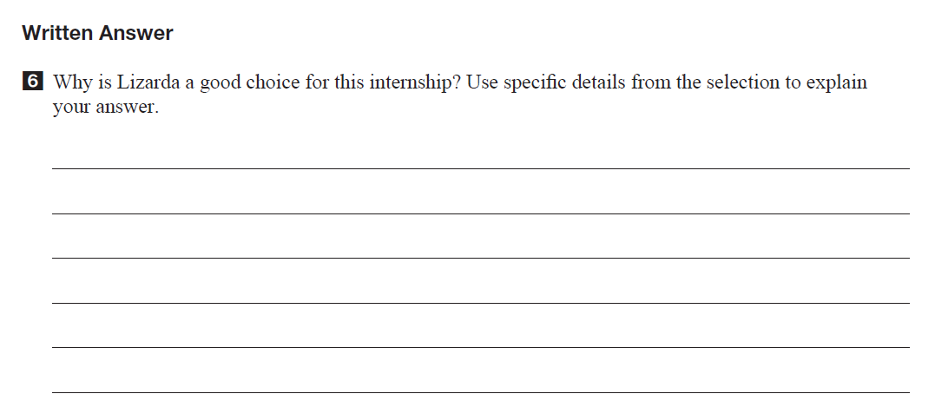
You will be answering all written response questions using a blue or black pen, or pencil, in the booklet on the lines provided.
The amount of lined space indicates the expected length of your response.

Slide 26
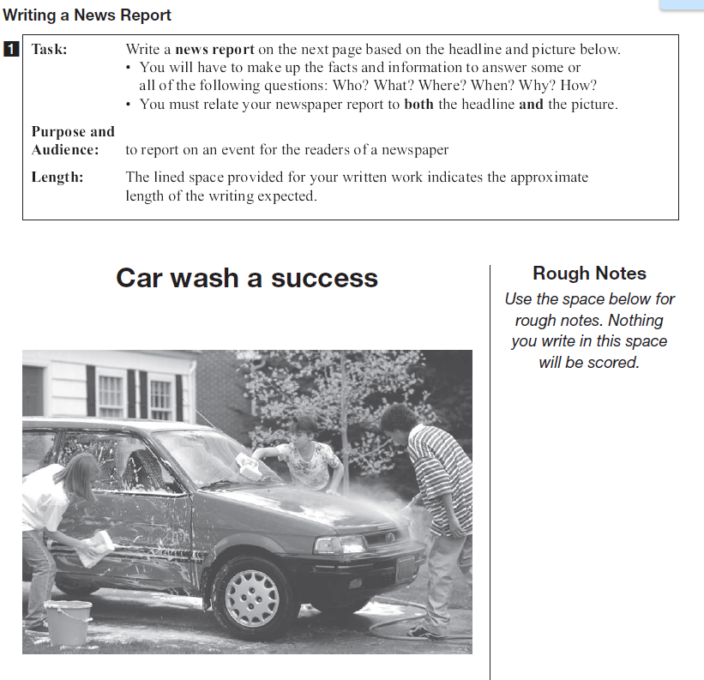
TEST PROTOCOL
Use the space provided for rough notes; jot down ideas and plan your response, but write your response in the lined space provided.
Work completed in the space for
rough notes will not be scored.

Slide 27
Responding to the readings
Identify what are you being asked to do.
Provide specific evidence from the readings (its okay to copy directly from the text).
Include examples directly stated from the text (statistics, numbers dates and other facts).

Slide 28
Writing Tips…
Answer with relevant specific details to support your point
Aim for at least three convincing supporting details
You may flip through the booklet to confirm the correct use of quotation marks, punctuation, etc.

Slide 29
Reading Tips
Read and review the questions before you read the text
Underline, highlight and make notes as you read
Refer back to the reading when recording your answers, do not simply rely on your memory

Slide 30
REMEMBER…
Once you have finished the appropriate booklet, review your work.
Check that you have not missed any pages or tasks.
You will not be allowed to leave the room early.

Slide 31
Visit www.eqao.com for sample questions, answers, and past tests.
This PowerPoint is available at www.earlhaig.ca

